Slide 1
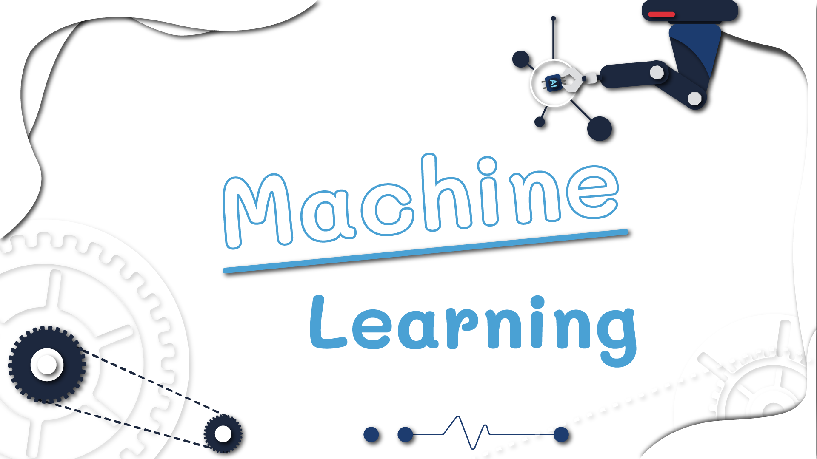

Slide 2





Topics
Machine Learning
What is Machine Learning?
Basic Machine Learning Concept.
Machine learning types.
Supervised learning.
Unsupervised learning.
Models and Algorithms.
Use of Machine learning.
Center of Excellence in AI and Emerging Technology

Slide 3
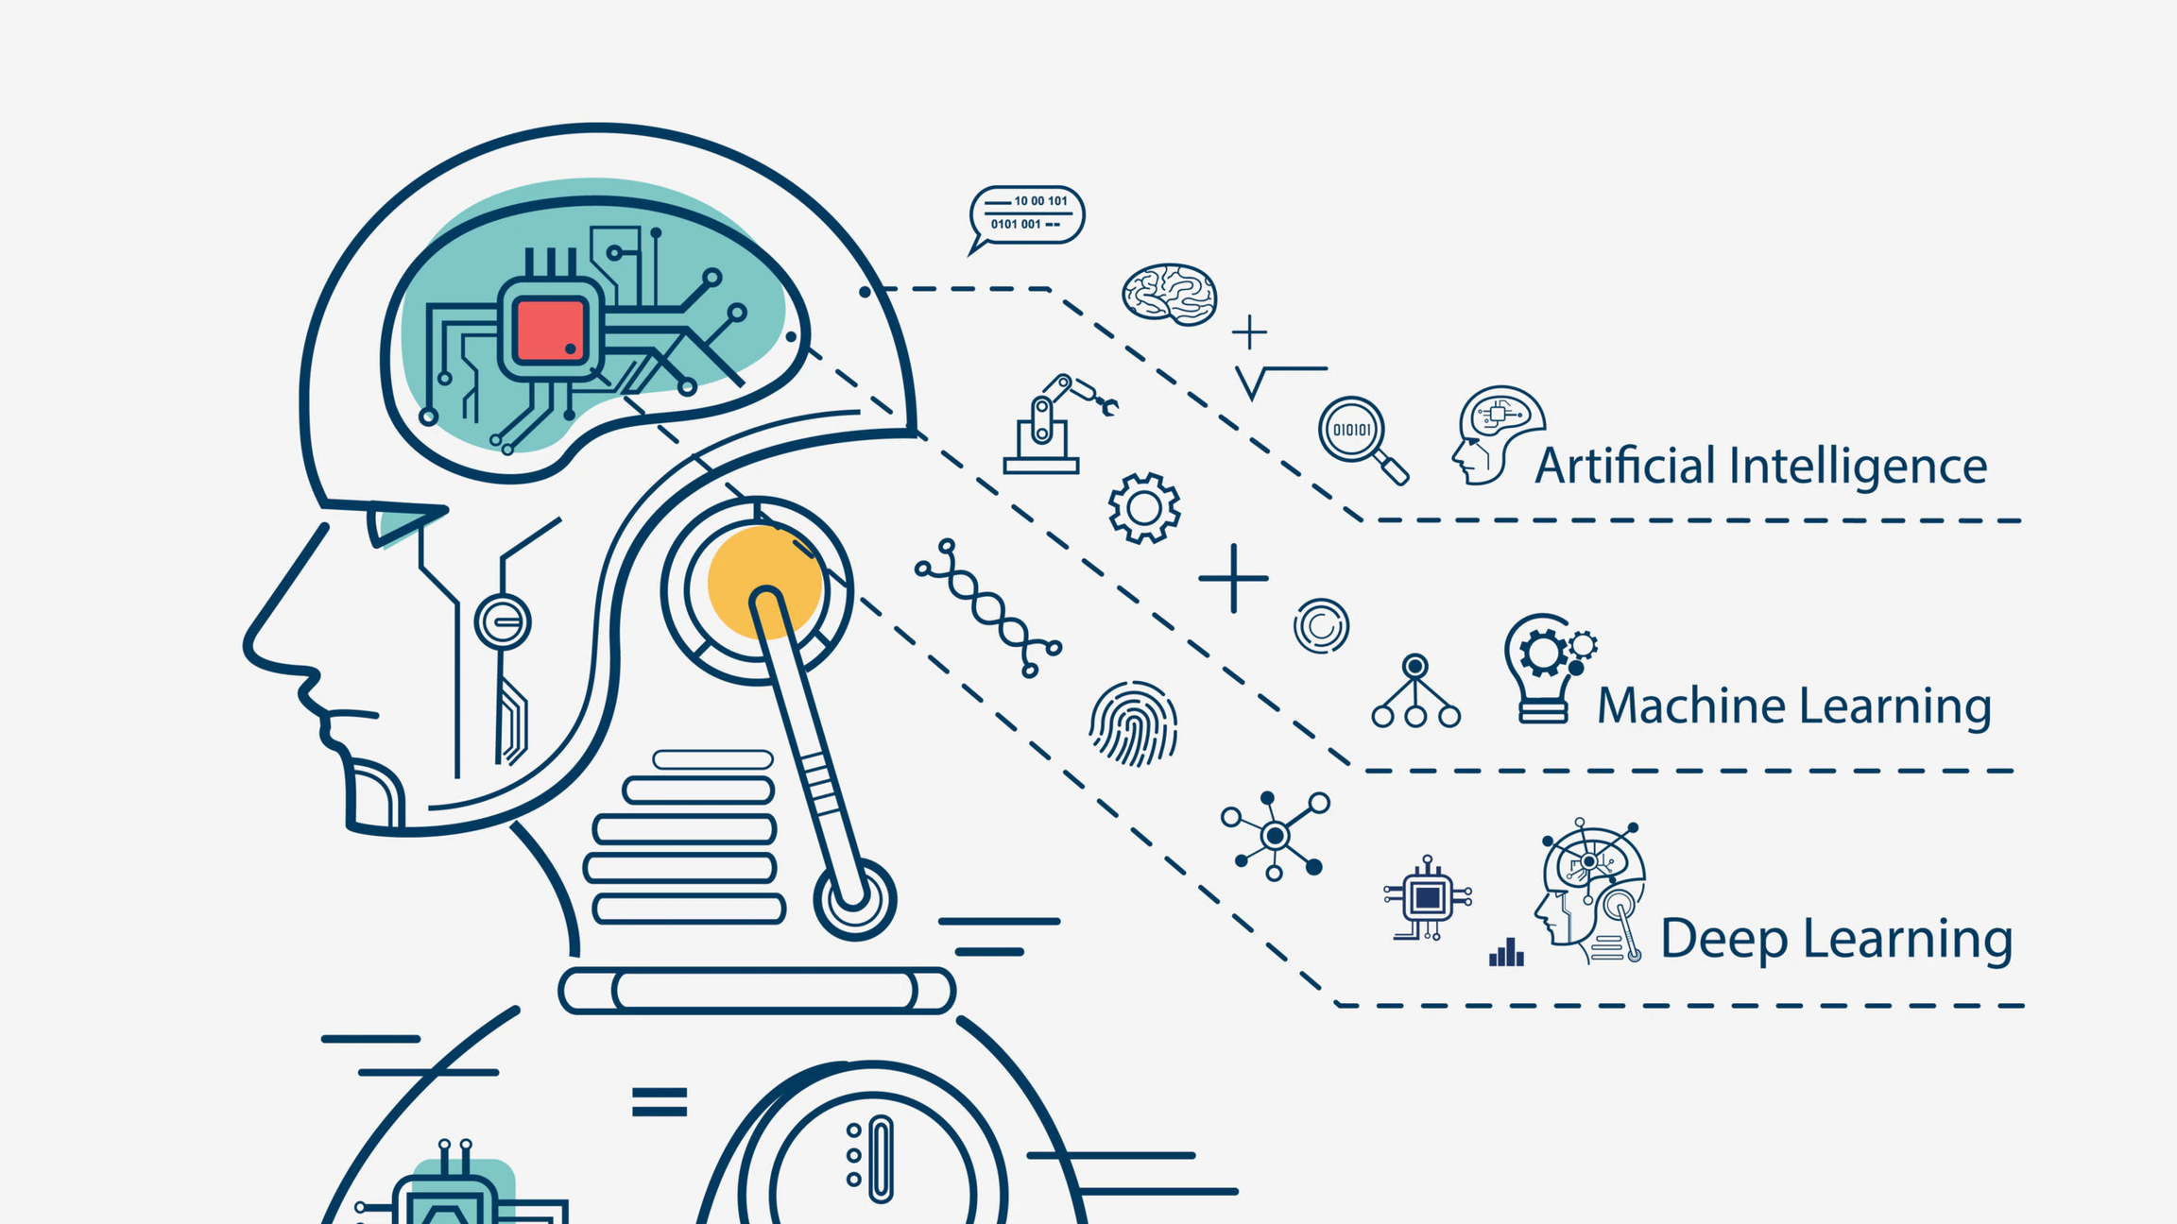
https://www.atriainnovation.com/en/machine-learning-in-industry/

Slide 4

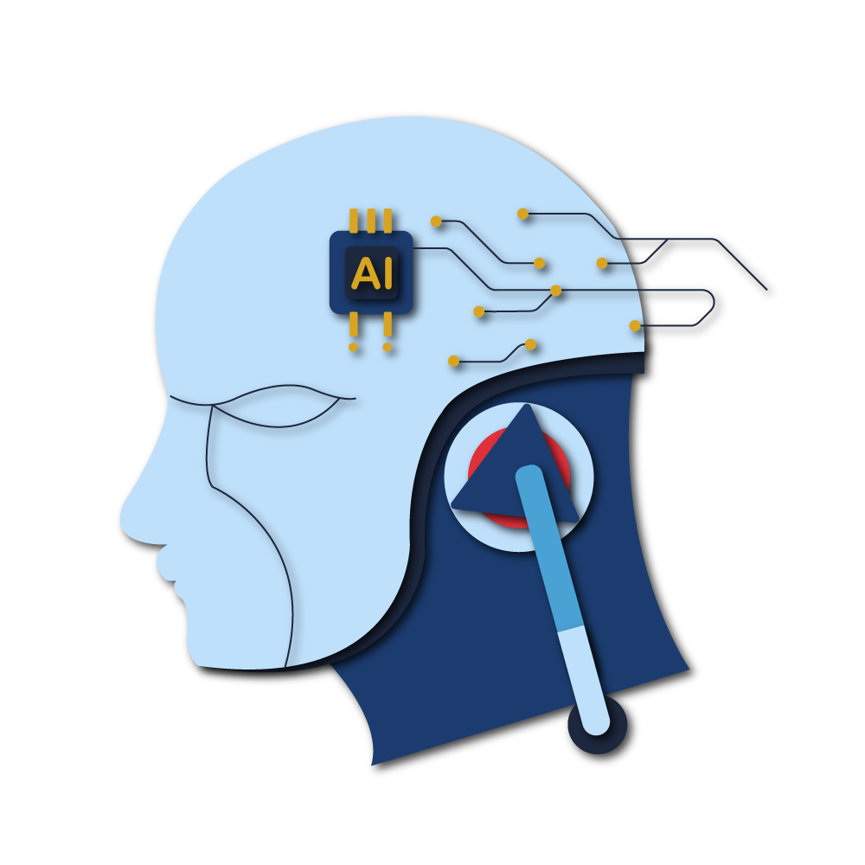
Machine Learning
Center of Excellence in AI and Emerging Technology

Slide 5
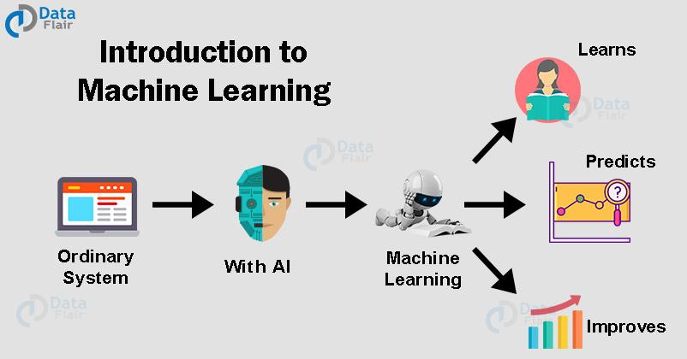
https://data-flair.training/blogs/machine-learning-tutorial/
Center of Excellence in AI and Emerging Technology

Slide 6
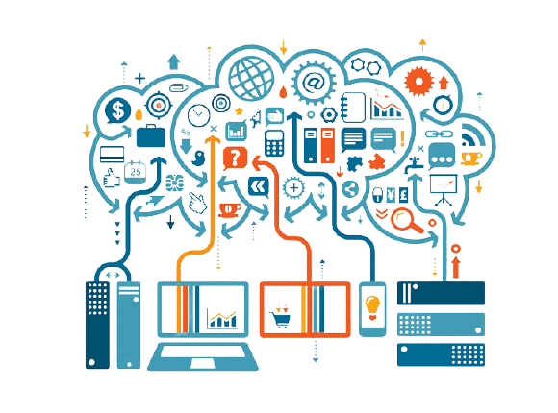
What is Machine learning?
Machine learning is a system that can learn on its own from examples without programmer input. This breakthrough came with the idea that computers could simply learn from data to produce accurate results.
https://bigr.io/deep-learning-neural-networks-iot/
Center of Excellence in AI and Emerging Technology

Slide 7
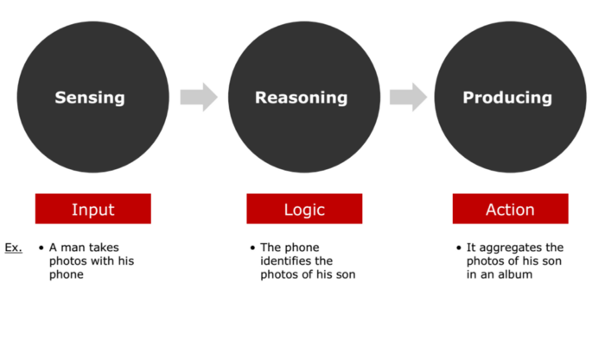
Concept of Machine Learning
How to do machine learning? First, putting data into the computer. Then the computers will analyze the data and find specific patterns. When the computer finds that pattern, it will adjust the way to process or organize data to reflect that pattern. After enough patterns are found, they can begin to make predictions. In general, if you enter more data for training, the computer will be more accurate and faster. Machine Learning can be divided into 3 types:
Supervised Learning
Unsupervised Learning
Reinforce Learning
https://medium.com/redpoint-ventures/three-things-you-need-to-know-about-machine-learning-99e6f5815aee
Center of Excellence in AI and Emerging Technology

Slide 8
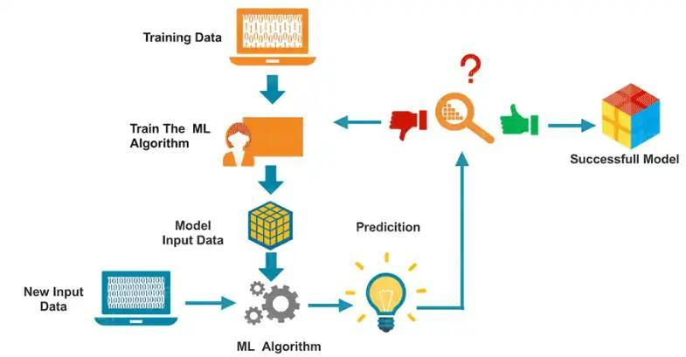
How does Machine Learning work?
https://www.corpnce.com/what-is-machine-learning-everything-you-need-to-know/
Center of Excellence in AI and Emerging Technology

Slide 9
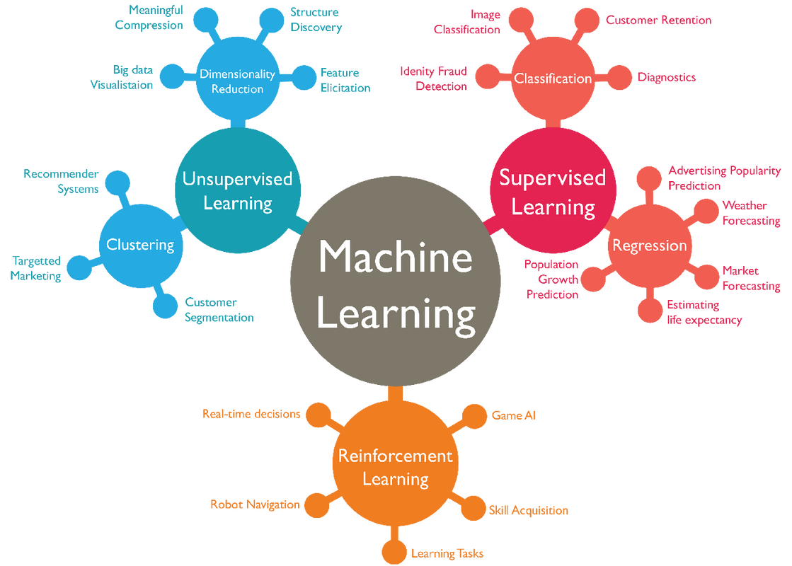
Types of machine learning
https://towardsdatascience.com/machine-learning-types-2-c1291d4f04b1
Center of Excellence in AI and Emerging Technology

Slide 10
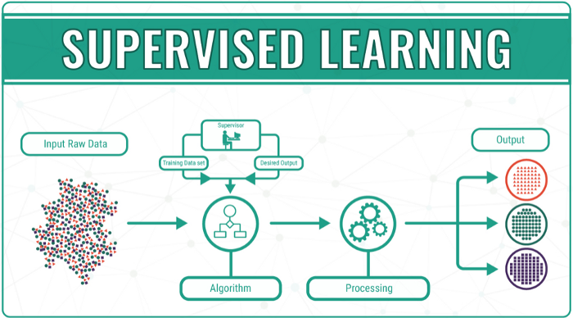
Supervised Learning
Supervised Learning is learning with a supervisor by using data to help technology predict outcomes more accurately.
https://chisoftware.medium.com/supervised-vs-unsupervised-machine-learning-7f26118d5ee6
Center of Excellence in AI and Emerging Technology

Slide 11
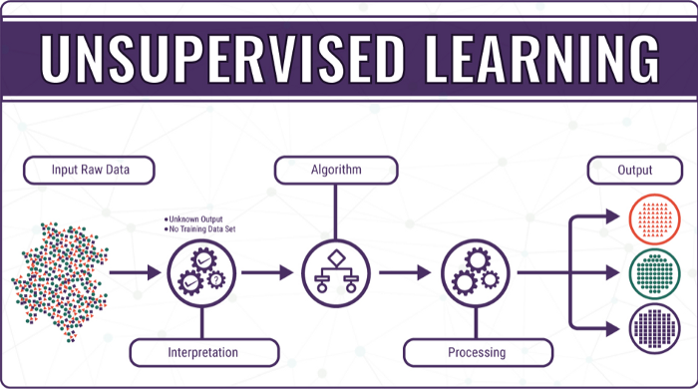
Unsupervised Learning
Unsupervised Learning is the opposite of Supervised Learning. It does not need to be taught from data. Unsupervised Learning can learn by itself
https://chisoftware.medium.com/supervised-vs-unsupervised-machine-learning-7f26118d5ee6
Center of Excellence in AI and Emerging Technology

Slide 12
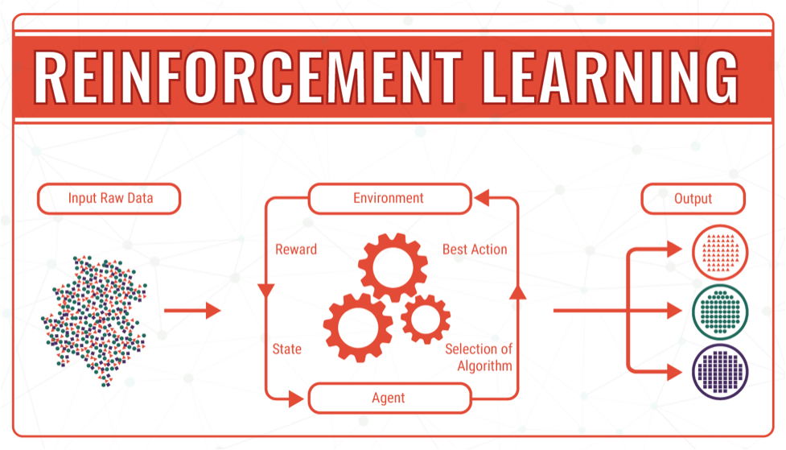
Reinforcement Learning
Reinforcement Learning is when the machine will learn that changes according to the conditions which can be learned on its own without the need for teaching information. Reinforcement Learning is very interesting because it is the closest thing to a human-like system or artificial intelligence (AI).
http://www.sra.vjti.info/blog/machine-learning/introduction-to-reinforcement-learning-in-2-minutes
Center of Excellence in AI and Emerging Technology

Slide 13
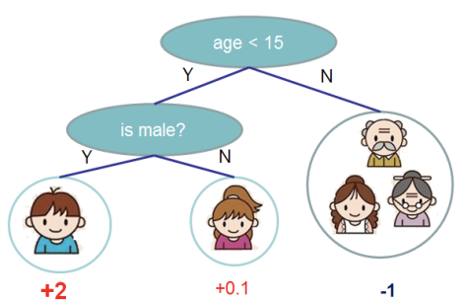
Supervised Learning Example
Decision Tree is a tree used to support decision making. It looks like an upside-down tree structure with roots at the top and leaves at the bottom. Within the tree there are nodes, each of which represents a decision based on data on various properties. Semi of the tree reaches the value or result obtained from the test. The leaves at the bottom of the decision tree represent the class or result at the top, called the root node.
Center of Excellence in AI and Emerging Technology

Slide 14
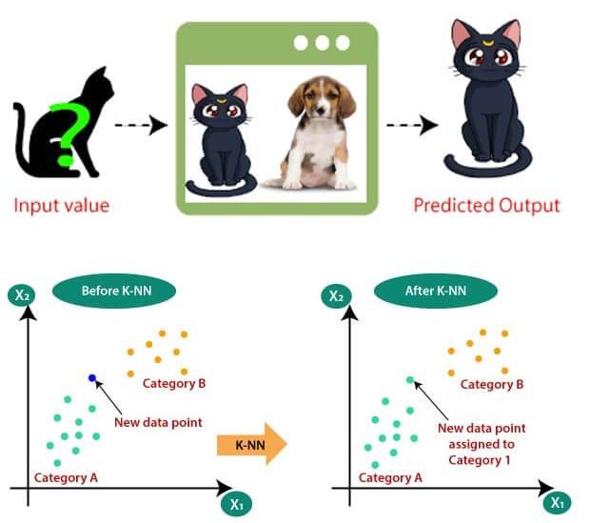
Supervised Learning Example
K-Nearest Neighbors (K-NN) is a method used for classification by using the principle of comparing data of interest with other data that are similar. If the data you are interested in is closest to any data, the system will give an answer that is the same as the answer for the closest data. The behavior does not use training data to build the model, but uses this data as a model.
https://pythonclass.in/k-nearest-neighbor-sklearn.php
Center of Excellence in AI and Emerging Technology

Slide 15

Unsupervised Learning Example
K-means or k-means data grouping is a method for managing data (Data mining) in the group of Unsupervised Learning or learning without teaching. The main function of K-means is clustering. This type of grouping is based on statistics. Of course, there must be at least 2 or more numbers involved.
https://towardsdatascience.com/k-means-data-clustering-bce3335d2203
Center of Excellence in AI and Emerging Technology

Slide 16
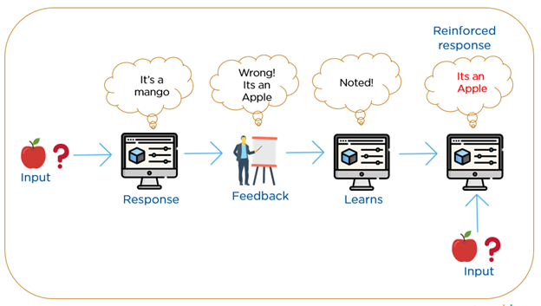
Reinforcement Example
https://blog.pjjop.org/intro-to-ai-machine-learning-and-ai-tool/
Center of Excellence in AI and Emerging Technology

Slide 17
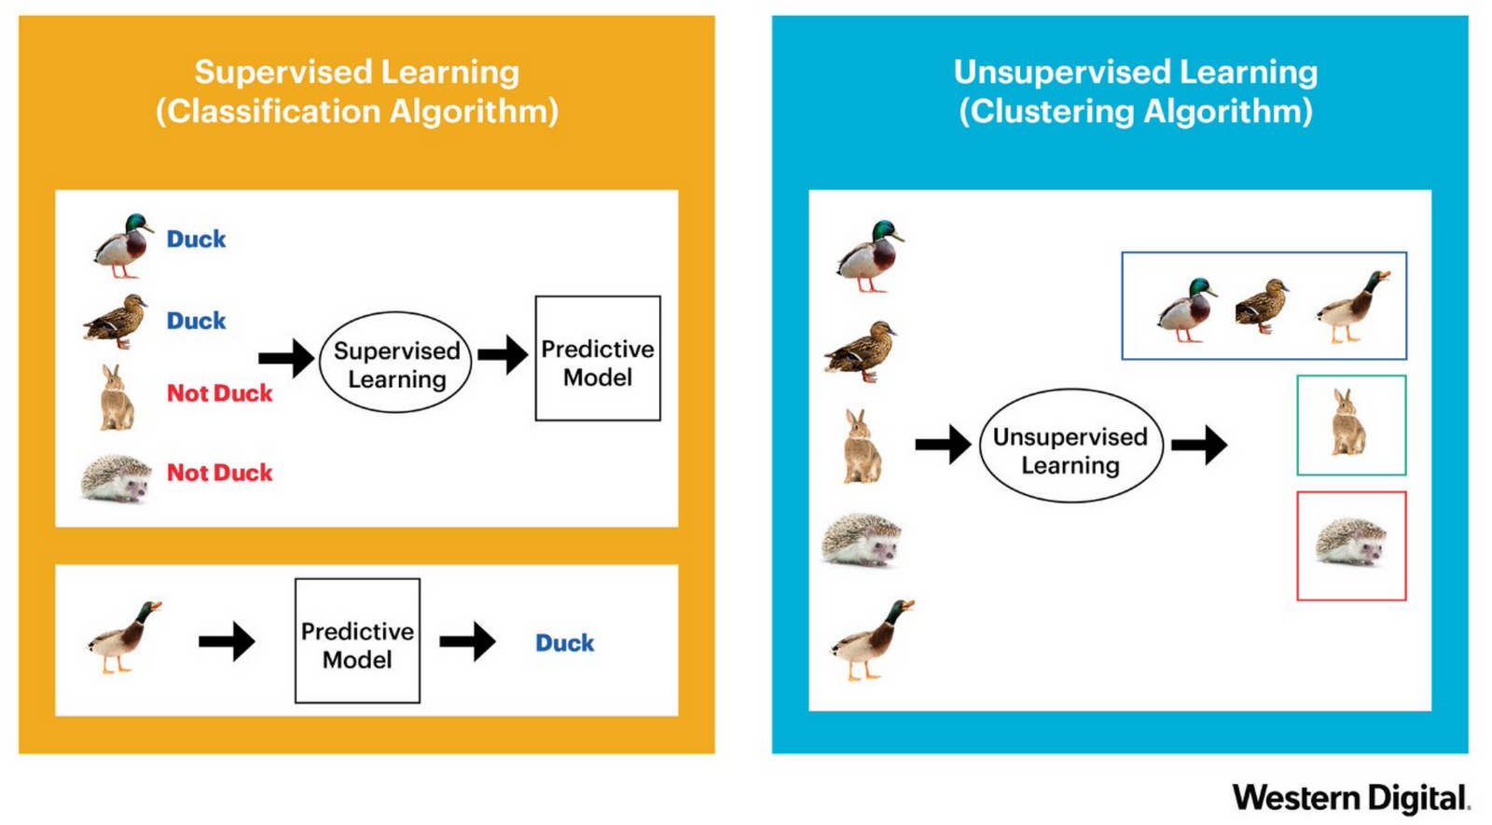
Compare the differences between Supervised Learning and Unsupervised Learning
https://blog.pjjop.org/intro-to-ai-machine-learning-and-ai-tool/
Center of Excellence in AI and Emerging Technology

Slide 18

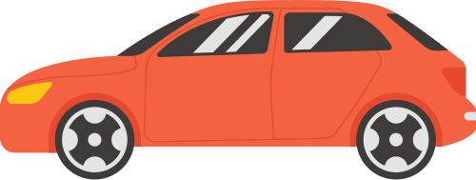

Examples of Machine Learning in everyday life
Apple Siri
Apple Face ID
https://www.pngwing.com/en/free-png-keslk
https://icon-library.com/icon/googlemaps-icon-16.html
Electric Vehicle
Digital Marketing
https://www.seekpng.com/ipng/u2w7i1y3i1i1o0o0_fraud-detection-icon-png/
https://www.flaticon.com/free-icon/online-advertising_1466288
Center of Excellence in AI and Emerging Technology

